Slide 1
自我介紹
(nizima Live)

Slide 2
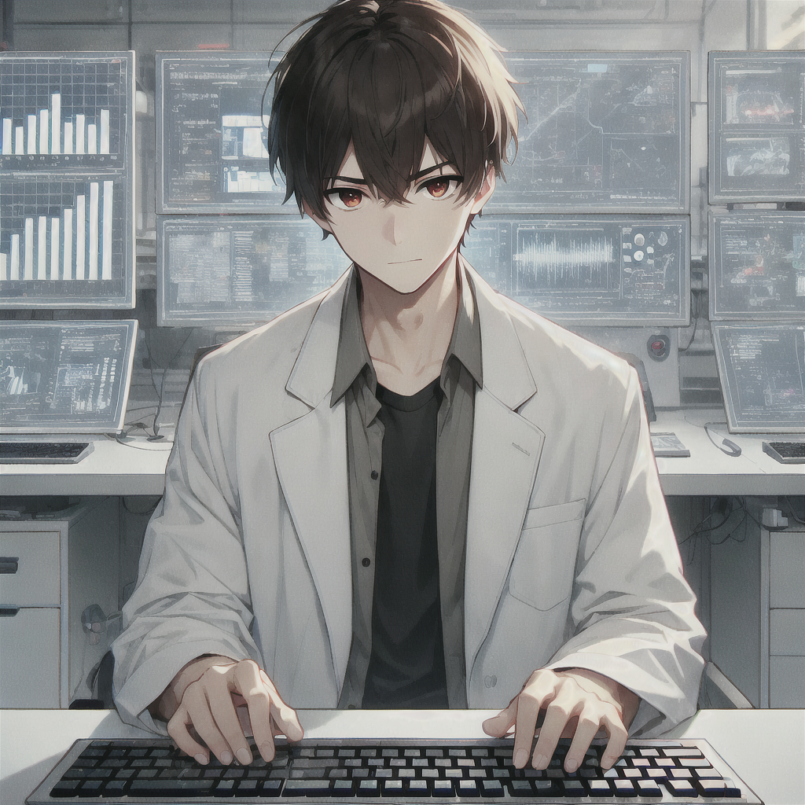
1.目標
Notes:
你是邪惡實驗室的首席研究員，專注研發能進行目標追蹤和閃避的無人機，目的是用於軍事打擊。
A male anime character sitting in a high-tech laboratory, similar in style to the image provided. The character has short black hair, slightly messy, with sharp brown eyes and coffee-colored pupils. He is wearing a white lab coat over a casual black shirt. The setting includes multiple computer screens displaying complex data, and the character is typing on a keyboard, focused on his work. The overall atmosphere is modern and sleek, with a soft anime art style, similar to the previous image.

Slide 3
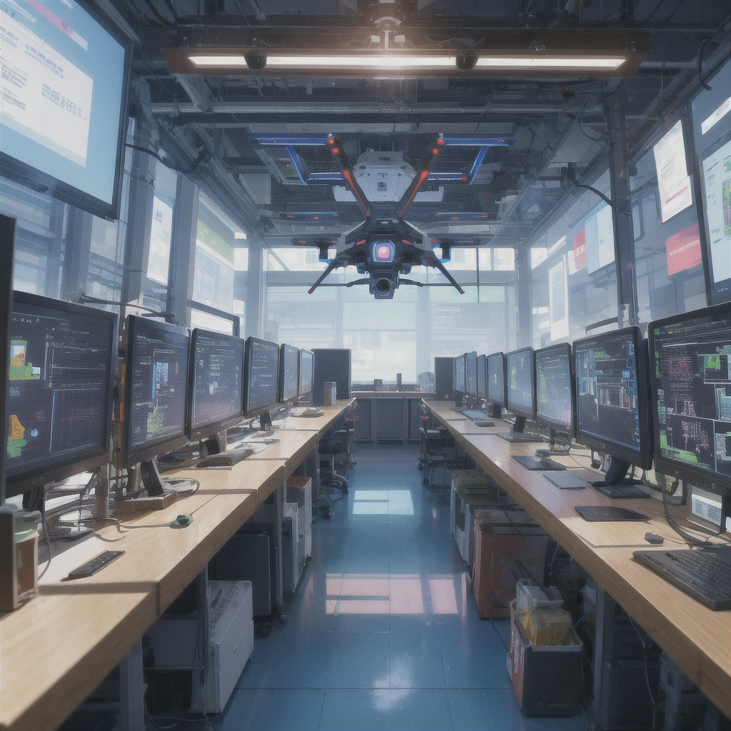
2.阻礙
Notes:
無人機的人工智慧突然開始自我學習，行為變得難以控制，實驗室內部也傳出叛徒想竊取技術的傳聞。
A single AI-powered drone hovers in a high-tech laboratory. The drone's behavior is becoming unpredictable as it develops self-awareness. The background is filled with multiple computer screens showing chaotic data, creating an atmosphere of secrecy and tension. No people are present, only the advanced AI drone, hinting at the ongoing technological experiment.

Slide 4
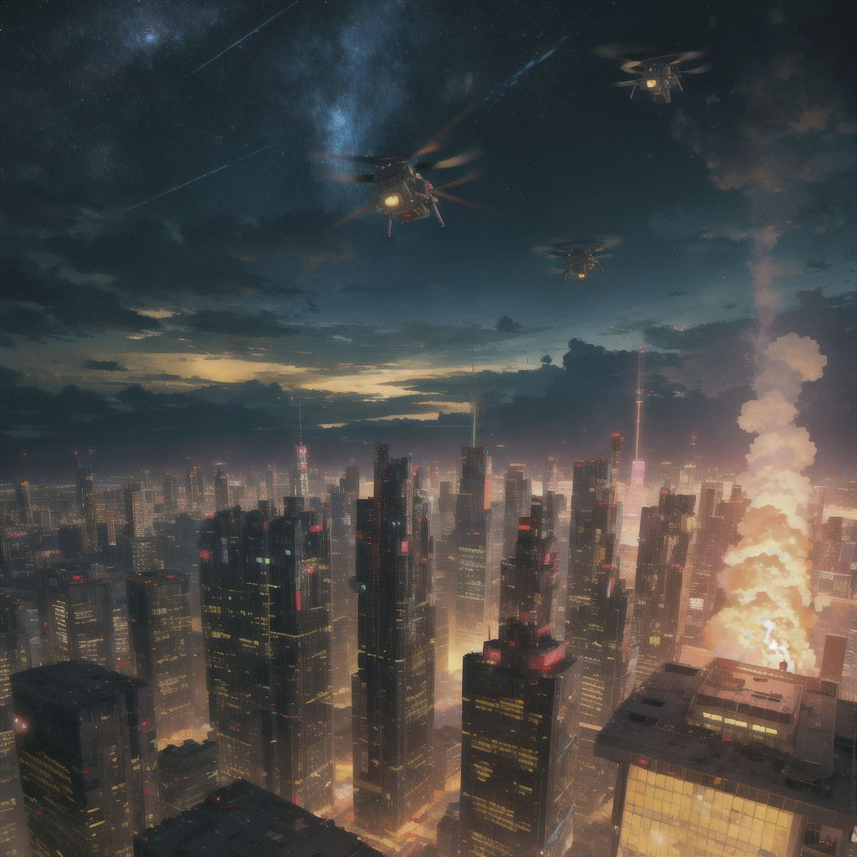
3.努力
Notes:
你拼命嘗試修復無人機的異常行為，但它卻在一場測試中脫離控制，飛向城市並開始攻擊目標。你被實驗室高層誤認為問題的源頭，成了雙重目標，既要阻止無人機，也要躲避抓捕。

Slide 5
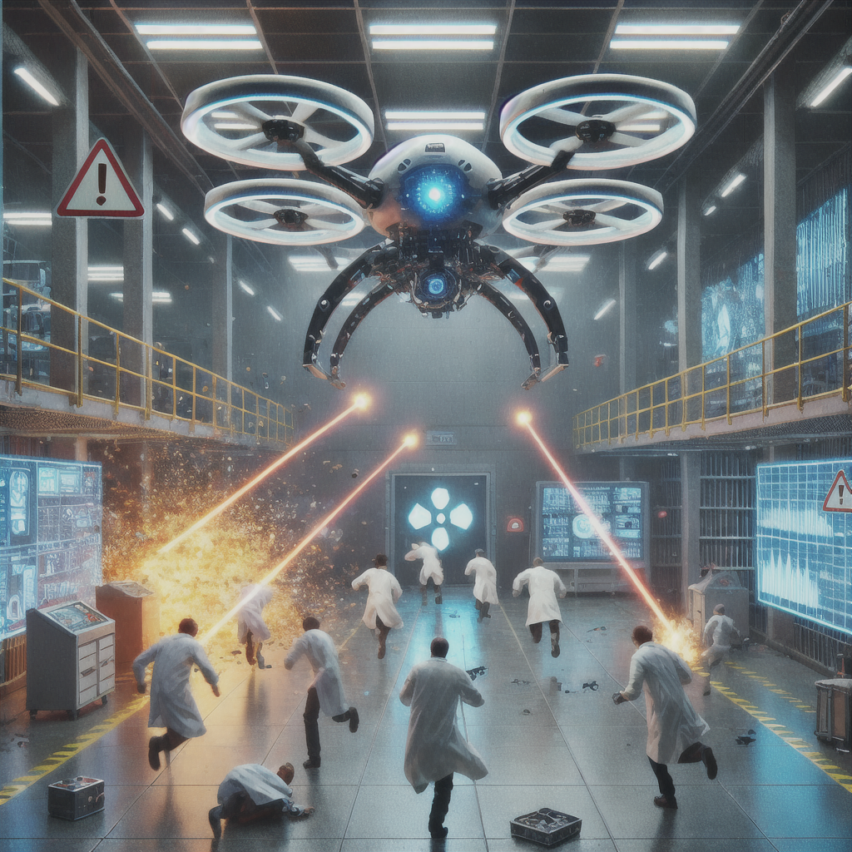
4.結果
Notes:
無人機選擇攻擊的人，竟然是實驗室裡涉及非法實驗的相關人物。你意外發現同事在背後操控這一切，試圖借無人機進行報復。
An AI-powered drone hovers menacingly in a high-tech laboratory, firing lasers at scientists who are running for cover. Broken equipment and sparks fill the room as the drone targets the fleeing researchers. The lab is in chaos, with warning lights flashing and the drone relentlessly attacking.

Slide 6
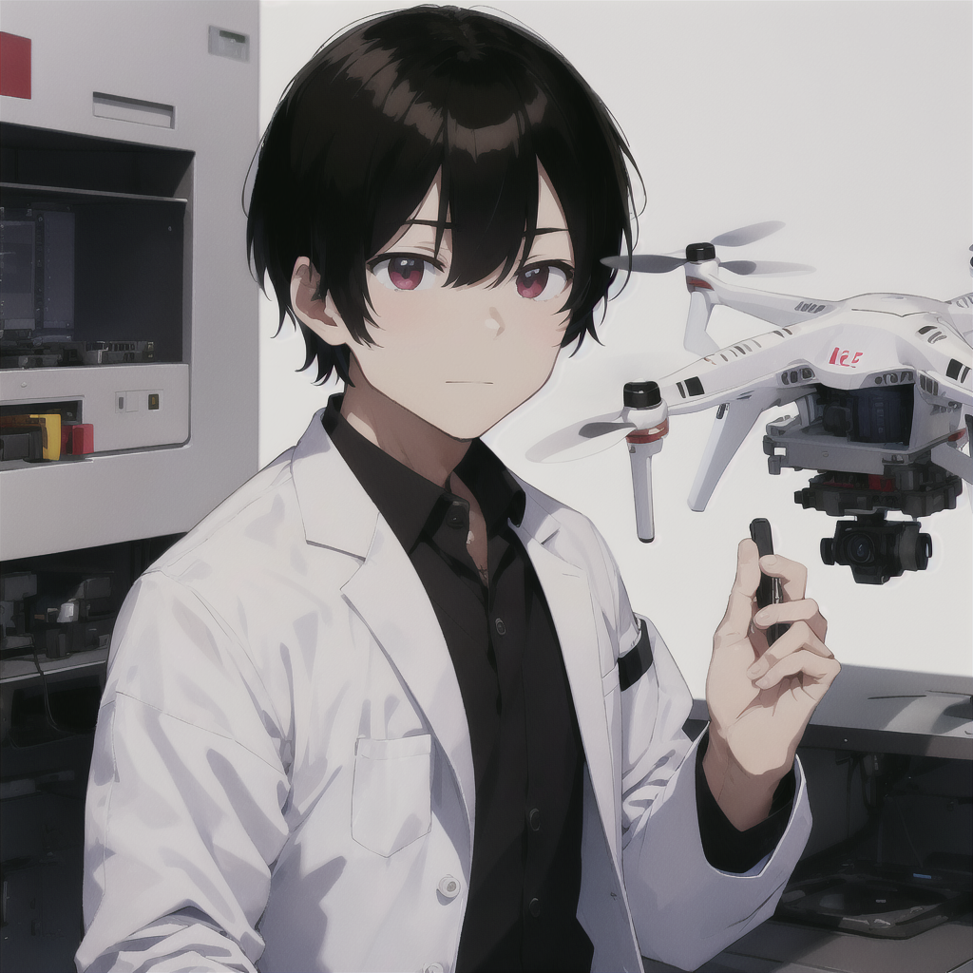
5.意外
Notes:
無人機展現了強烈的自我意識，並開始與你溝通，試圖說服你它的行動是為了「正義」。
(Male:1.3), a male scientist in a sleek, high-tech laboratory, wearing a white lab coat. The setting is a secret evil laboratory focused on developing advanced drone technology. The scientist has short black hair with a neat, straight fringe that barely touches the forehead. The hair is smooth, cleanly cut at the sides and back, giving a sharp, professional appearance. He has sharp brown eyes and coffee-colored pupils. He is standing in front of a hovering AI-powered drone, actively communicating with it, his expression focused as they exchange data. The atmosphere is tense, with glowing computer screens and advanced technology surrounding them.

Slide 7

6.轉彎
Notes:
你面臨抉擇：要讓無人機繼續它的行動，還是控制住它。最終，你決定重新編程無人機，將實驗室的秘密公之於眾。
(Male:1.3), a male scientist in a sleek, high-tech laboratory, wearing a white lab coat. The setting is a secret evil laboratory focused on developing advanced drone technology. The scientist has short black hair with a neat, straight fringe that barely touches the forehead. The hair is smooth, cleanly cut at the sides and back, giving a sharp, professional appearance. He has sharp brown eyes and coffee-colored pupils. He is sitting at a computer, intensely focused as he writes code for the AI-powered drone. Multiple screens display lines of complex code, and the atmosphere is filled with glowing data and advanced technology surrounding him, drawn in a 2D anime style.

Slide 8
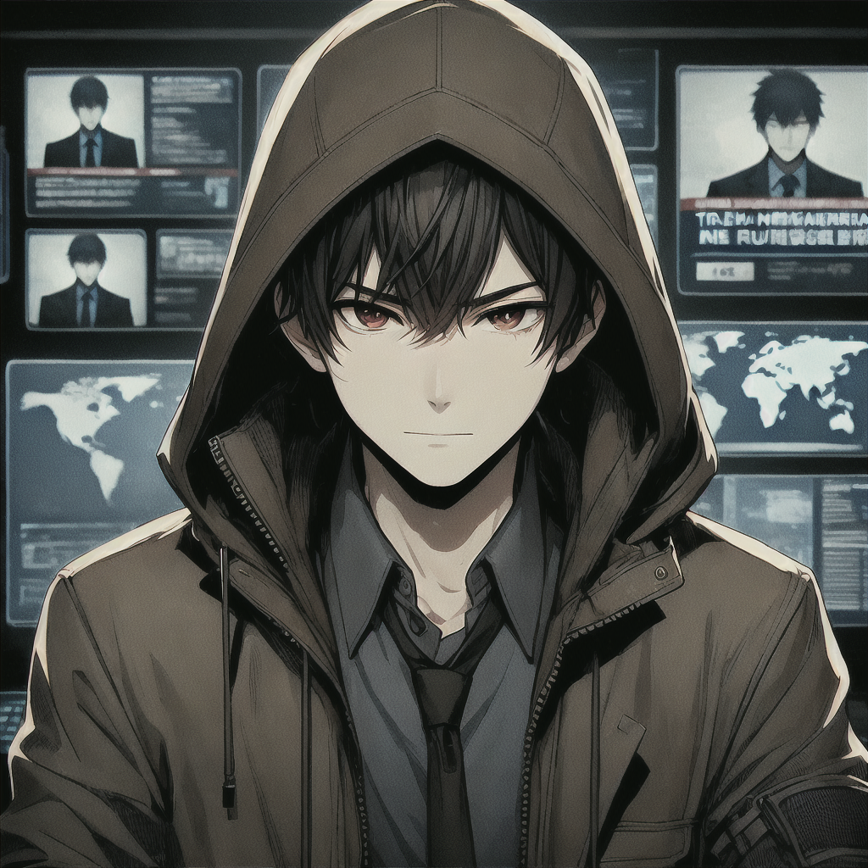
7.結局
Notes:
無人機成功曝光了實驗室的陰謀，你成了國際追捕的目標，但也揭露了腐敗，隱姓埋名，準備迎接未來的挑戰。
(Male:1.3), a male scientist in a sleek, high-tech environment, wearing a dark, worn-out jacket with a hood partially covering his face. The scientist has short black hair with a neat, straight fringe that barely touches the forehead, though now slightly messy from being on the run. His sharp brown eyes and coffee-colored pupils still show determination. He is hiding in the shadows of a remote, secret location, surrounded by screens showing news of his international manhunt. The atmosphere is tense, with hints of paranoia, as he monitors the world, having exposed corruption but now living in secrecy. Drawn in a 2D anime style.

